Slide 1
Machine learning studio
The laboratory work 14

Slide 2
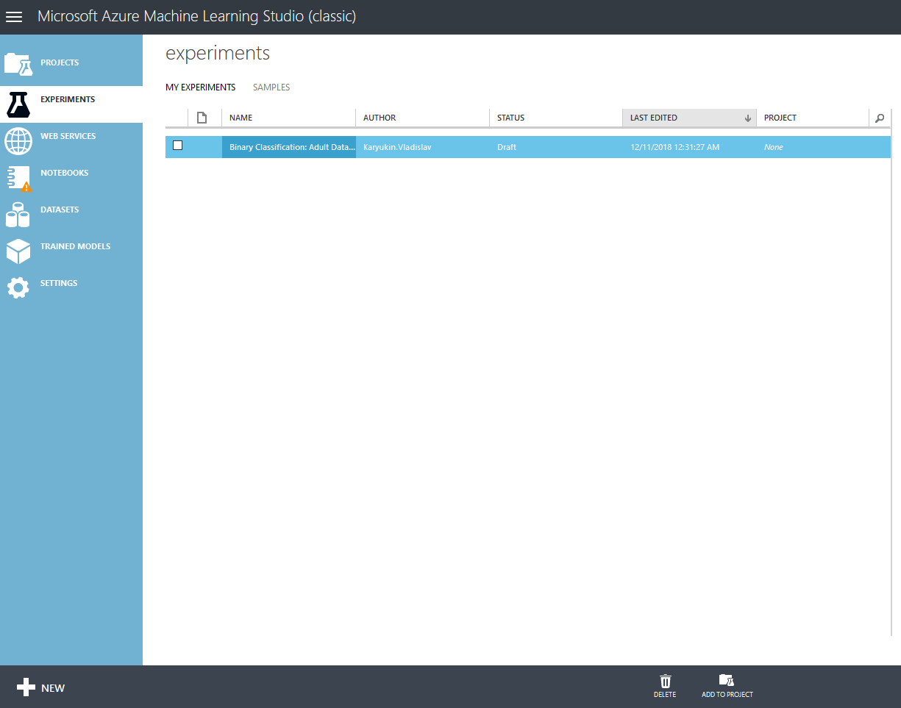
Machine learning studio
When you open ML Studio, you will see the following work space there

Slide 3
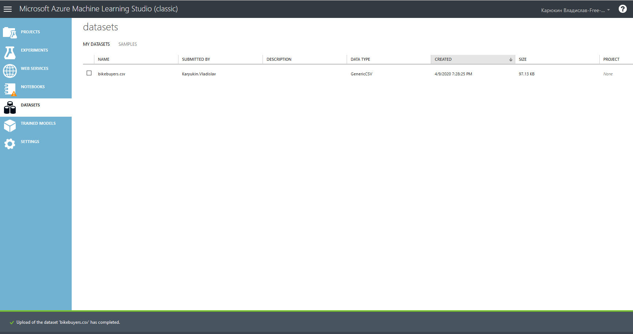
Machine learning studio
Load data from csv file

Slide 4
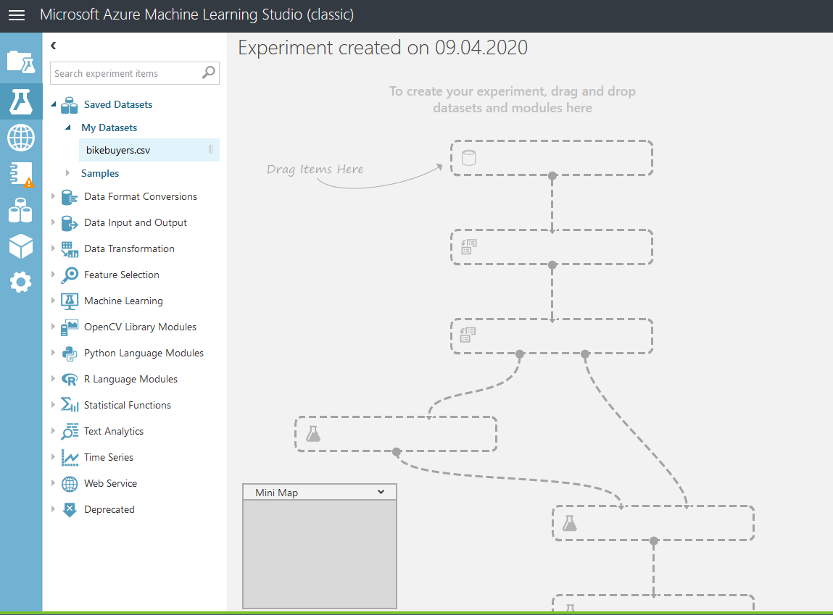
Machine learning studio
Creating a new experiment

Slide 5
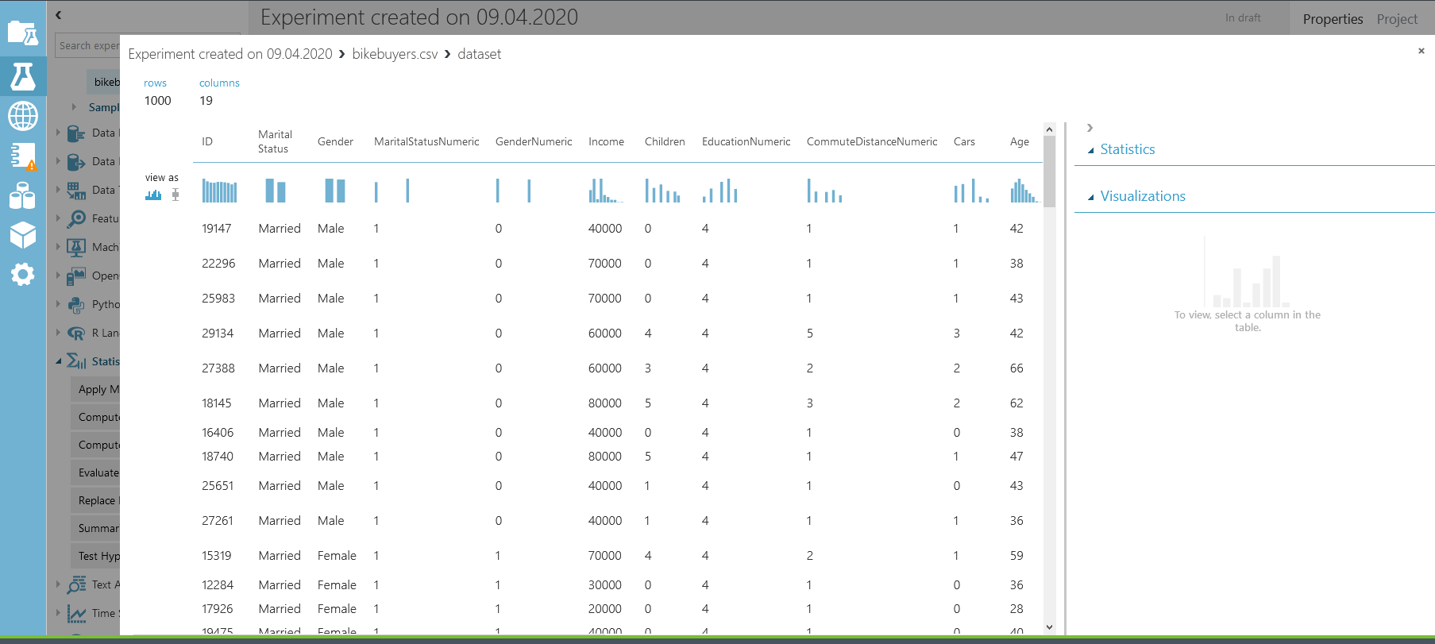
A new experiment
Visualizing data

Slide 6
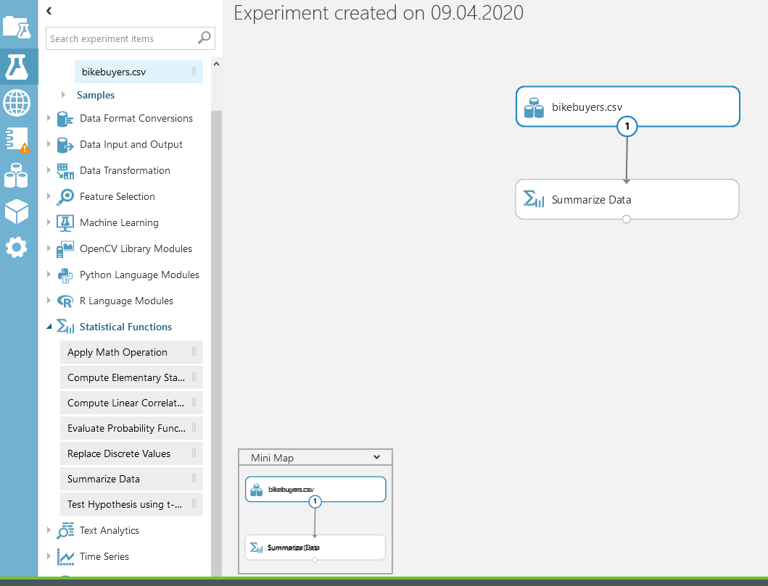
A new experiment
Summarizing data

Slide 7
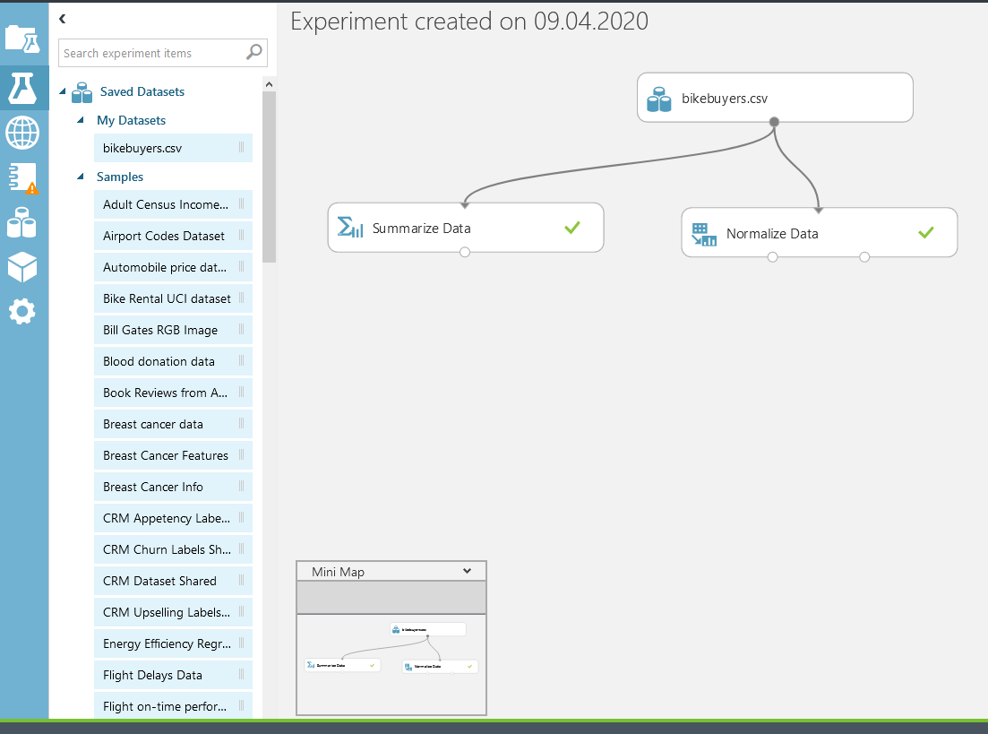
A new experiment
Normalizing data

Slide 8
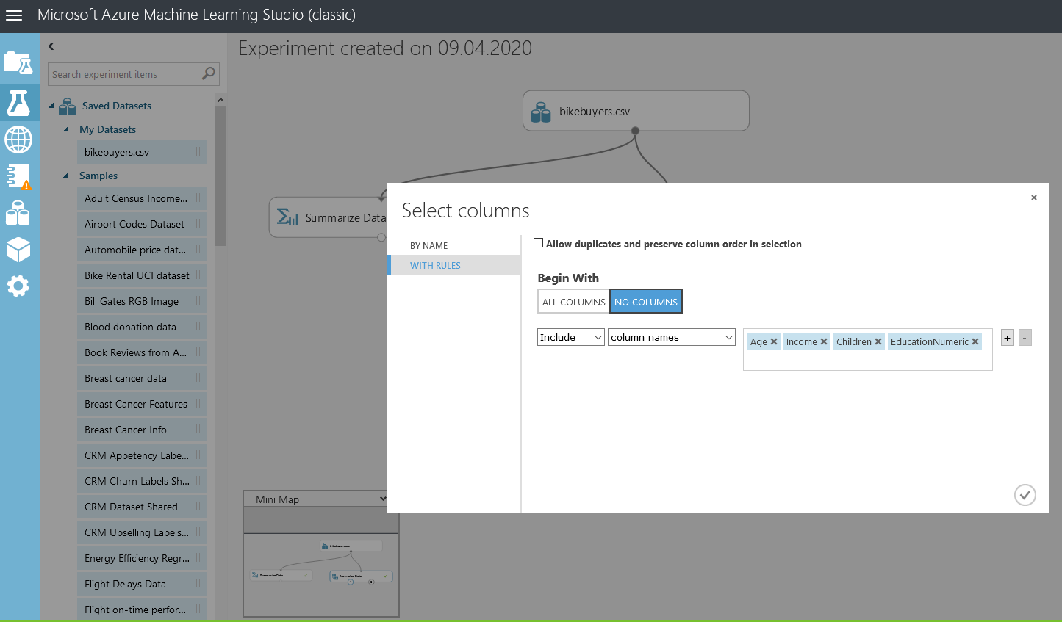
A new experiment
Choosing a list of columns from the dataset

